Slide 1
PoC for OpenSSL/MbedTLS w/ KCMVP
2023.03.17
kangchan091@skuniv.ac.kr
hotteok@skuniv.ac.kr

Slide 2
Testbed
Server (Master)
Service : Oracle Cloud Instance
CPU : Amd x86_64
OS : Ubuntu 18.04.6 LTS 64bit
Kernel : 5.4.0
InfluxDB : 2.6.1
Grafana : 9.3.6
Embedded (Outstation)
Model : Raspberry pi 3 model B+
CPU : ARM Cortex-A53
OS : Debian GNU/Linux 11 32bit
Kernel : 5.15.84
Sensor : LDR(Light-Dependent Resistor) Sensor
ADC : MCP3208

Slide 3

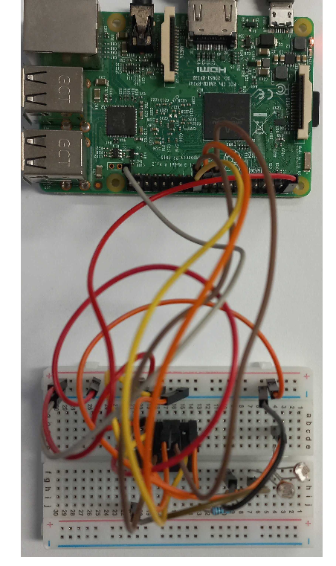









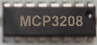
Overview
HDMI
Sensor Data TLS w/ KCMVP
Outstation
Outstation Sensor
ADC
LDR Sensor
Wireshark Client
Monitoring Client
Master Server
Outstation Sensor

Slide 4
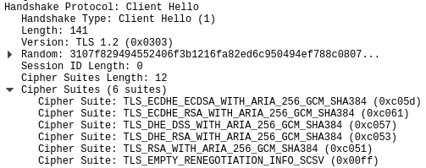
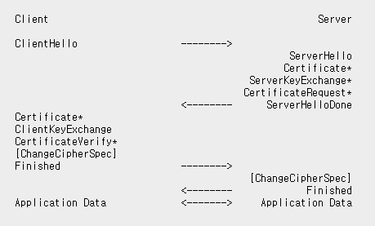
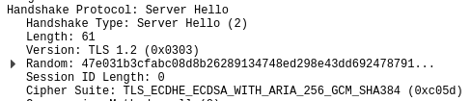
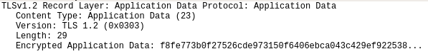
TLS Packet
*RFC5246 인터넷 표준화 기구에서 관리하는 기술 표준 중
하나로 TLS 1.2 프로토콜에 대한 표준을 기술
*Data = “782.5”

Slide 5
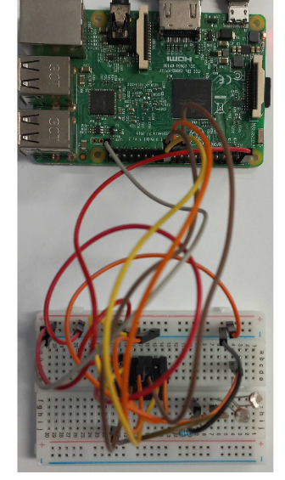

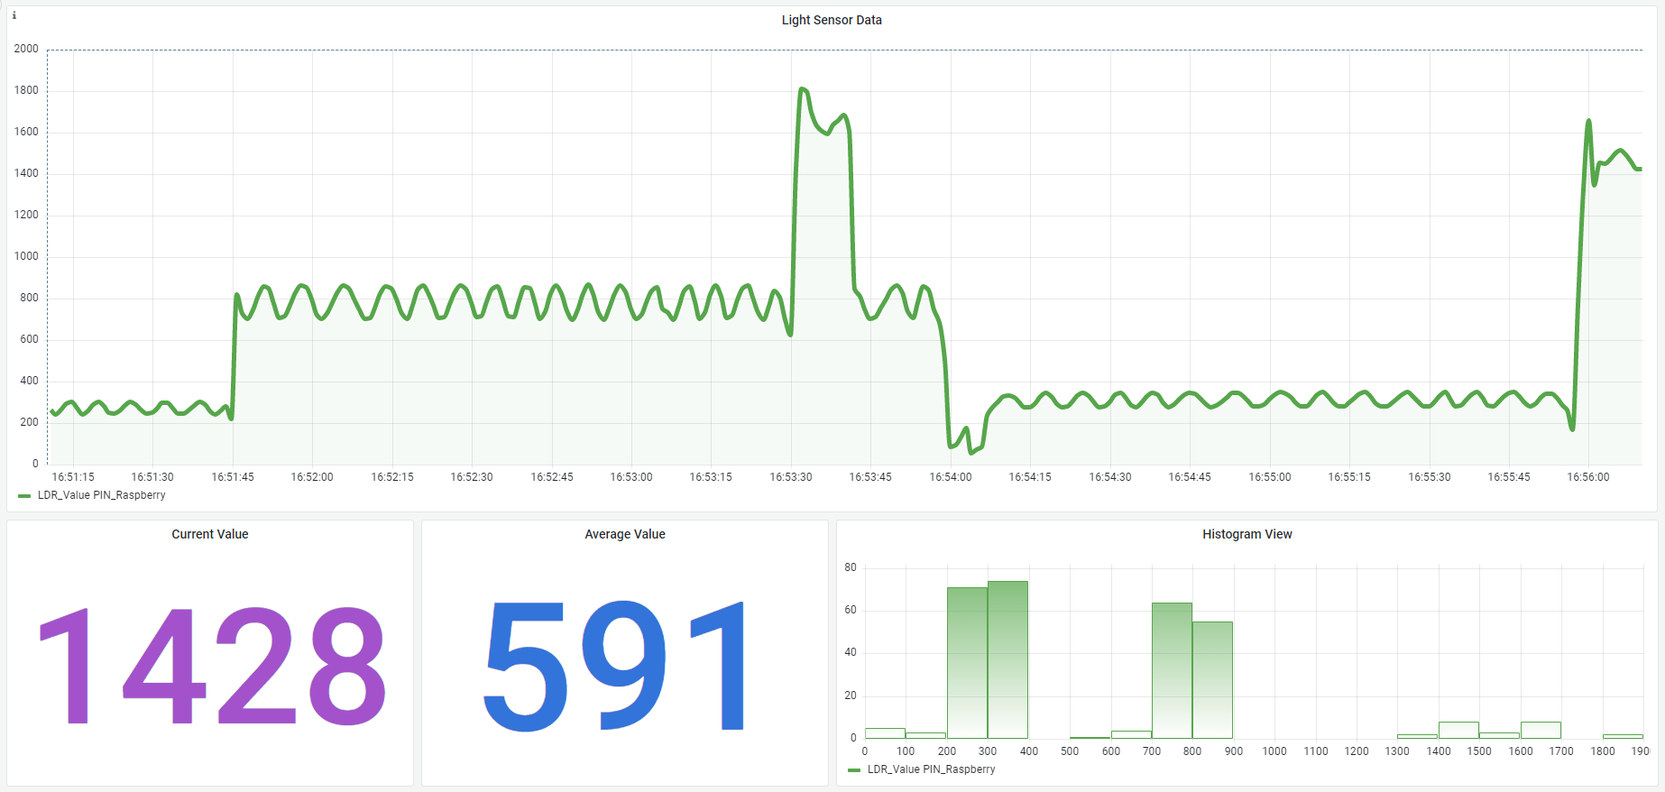


Overview (cont’d)
Sensor Data TLS w/ KCMVP
Influxdb Table
Outstation
_time | Outstation | _field | _value
… | … | … | …
2023-03-08T07:56:09.939Z | PIN_Rasp | LDR_Value | 1428
2023-03-08T07:56:10.948Z | PIN_Rasp | LDR_Value | 1456
2023-03-08T07:56:11.943Z | PIN_Rasp | LDR_Value | 1492
… | … | … | …
ADC
LDR Sensor
*time format : RFC3339 UTC를 기준으로 하는 24시간제 날짜 포맷 표준
Outstation Sensor
Query
Grafana Visualization
Monitoring Client
Master Server

